Slide 1
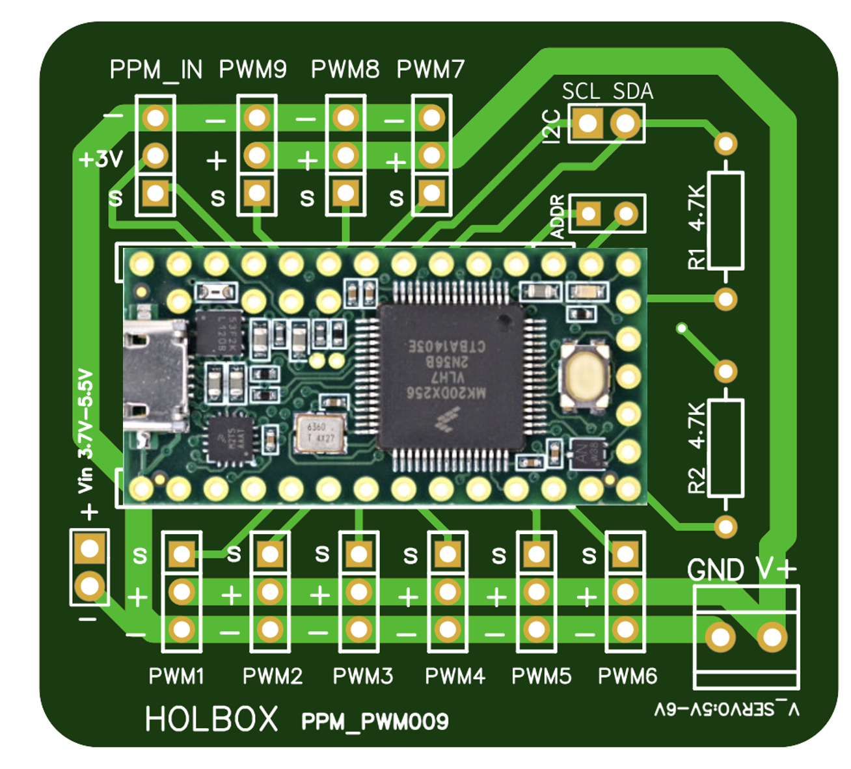
1. Board Pins: PPM_PWM009
Copyright 2021 Holbox Corporation

Slide 2
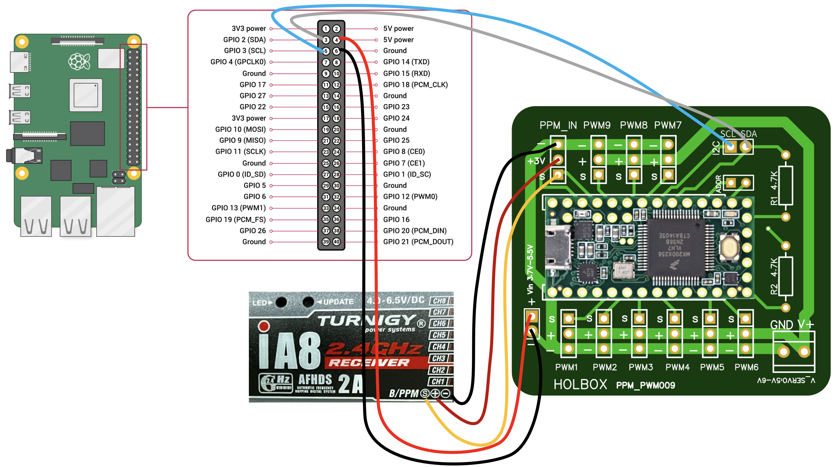
2. Connection for RC read (PPM decoding)
In this connection, no additional external power is needed for the RC receiver.
Copyright 2021 Holbox Corporation

Slide 3
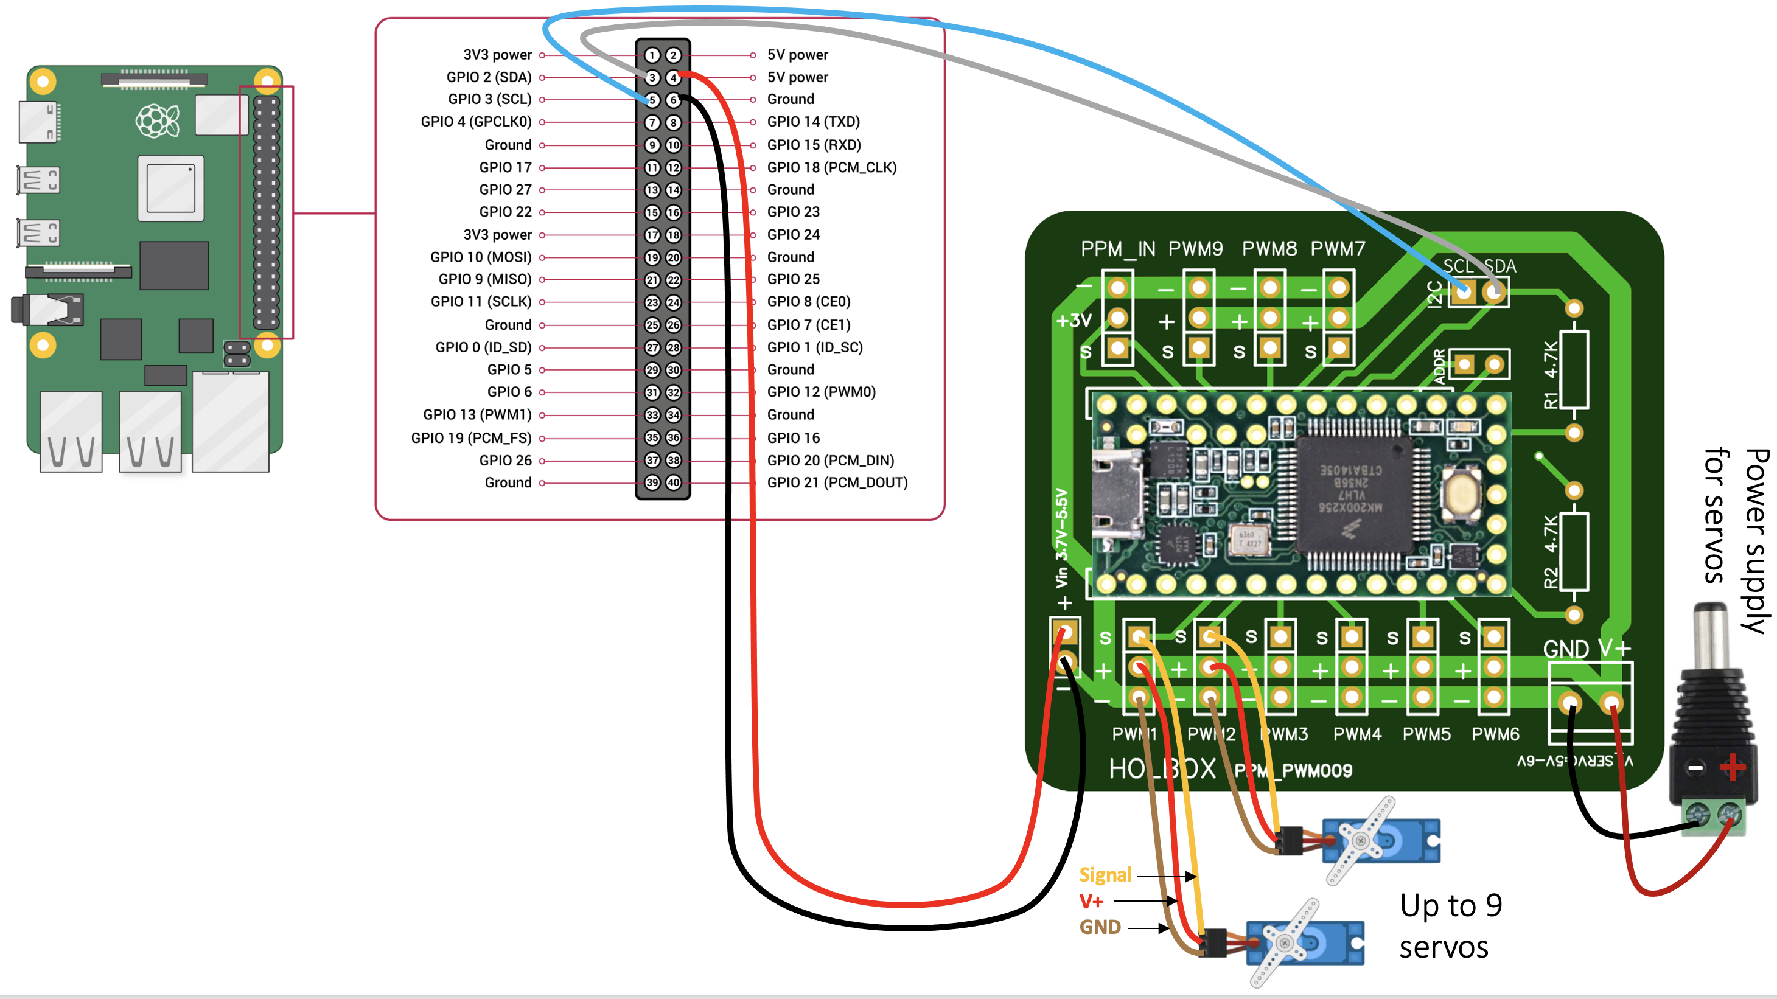
3. Connection for Servo/Brushless control
Copyright 2021 Holbox Corporation

Slide 4
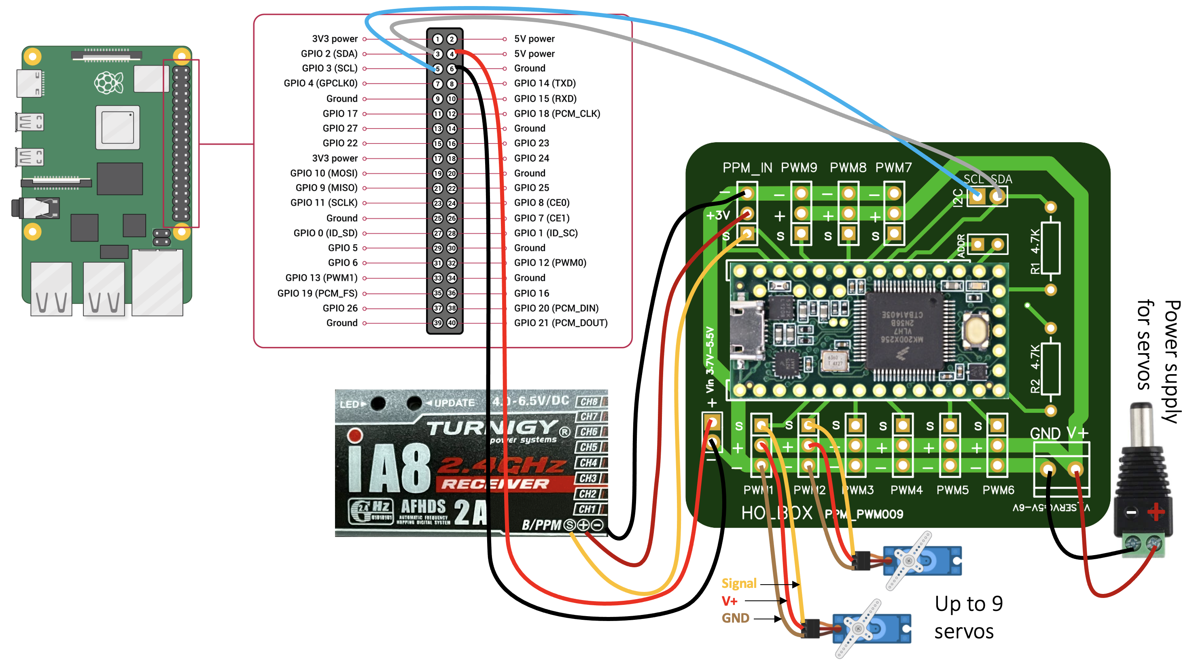
4. Connection for RC read (PPM decoding) and Servo/Brushless control
In this connection, no additional external power is needed for the RC receiver.
Copyright 2021 Holbox Corporation

Slide 5
5. Change I2C address
Copyright 2021 Holbox Corporation

